Slide 1
History Of Computers
Created By : Jesse Cardoso, Kyle Balsdon & Justin Bukovec

Slide 2
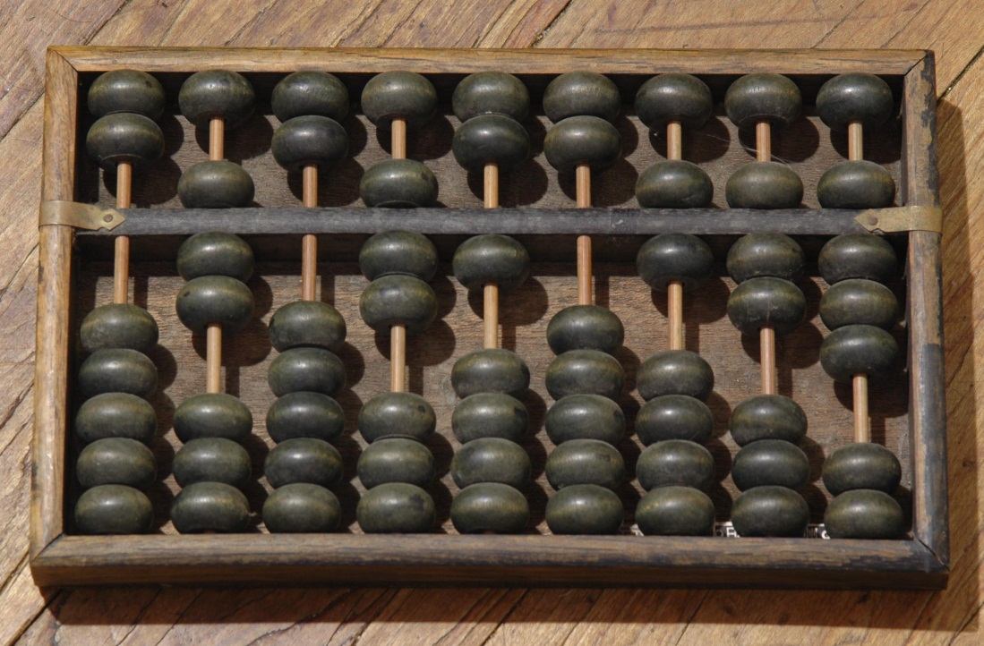
Abacus1600BC
The Abacus, also known as the “Counting Frame”. Created in the 1600’s, the Abacus was used by the Mesopotamian, Egyptian, Persian, Greek, Roman and many more.

Slide 3
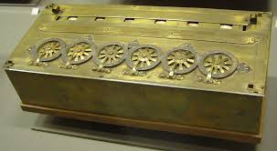
The Pascaline 1642
Blaise pascal invented the first digital calculator to help his father with his work collecting taxes. The user would dial the numbers he/she wanted to add together and the machine would automatically add them.

Slide 4
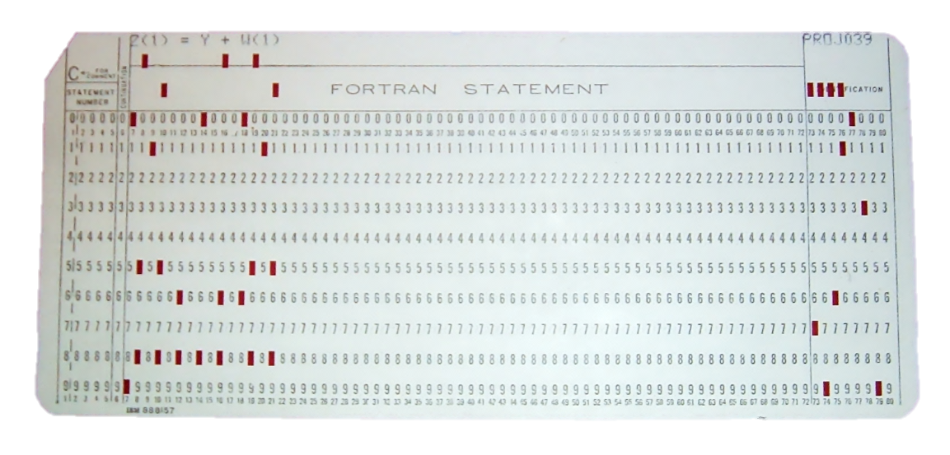
Fortran1950’s
Fortran (Derived from Formula Translating System) is a general-purpose programming language that is especially suited for scientific computing. Originally developed by IBM in the 1950s for scientific and engineering applications, Fortran came to dominate this area of programming early on and has been in continual use for over half a century. It is one of the most popular languages in the area of high-performance computing and is the language used for programs that benchmark and rank the world's fastest supercomputers.

Slide 5
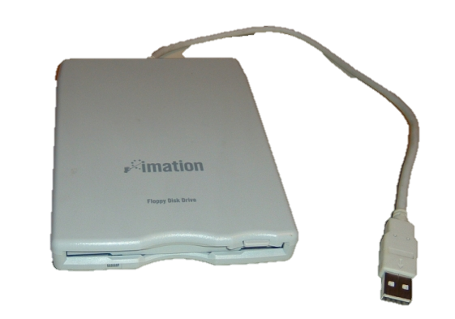
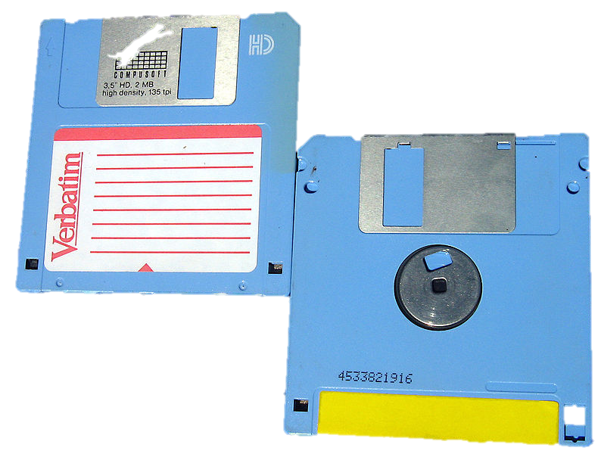
The Floppy Disk1970’s
A floppy disk, or diskette, is a disk storage medium composed of a disk of thin and flexible magnetic storage. Its sealed in a rectangular plastic carrier lined with fabric that removes dust particles. Floppy disks are read and written by a floppy disk drive (FDD).

Slide 6
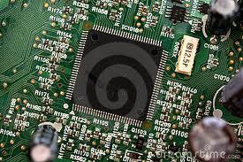
Integrated Circuit
An integrated circuit or monolithic integrated circuit (also referred to as an IC, a chip, or a microchip) is a set of electronic circuits on one small plate ("chip") of semiconductor material, normally silicon. This can be made much smaller than a discrete circuit made from independent components. Integrated circuits are used in virtually all electronic equipment today and have revolutionized the world of electronics.

Slide 7
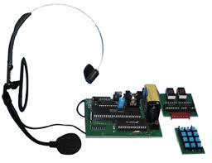
Speech Recognition
In computer science, speech recognition (SR) is the translation of spoken words into text. It is also known as "automatic speech recognition", "ASR", "computer speech recognition", "speech to text", or just "STT".

Slide 8
Gesture Recognition
Gesture recognition is a topic in computer science and language technology with the goal of interpreting human gestures via mathematical algorithms. Gestures can originate from any bodily motion or state but commonly originate from the face or hand. Current focuses in the field include emotion recognition from the face and hand gesture recognition. Many approaches have been made using cameras and computer vision algorithms to interpret sign language. However, the identification and recognition of posture, gait, proxemics, and human behaviors is also the subject of gesture recognition techniques.

Slide 9
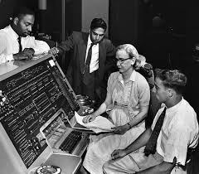
Grace Hopper
Grace Murray Hopper (December 9, 1906 – January 1, 1992) was an American computer scientist and United States Navy rear admiral. A pioneer in the field, she was one of the first programmers of the Harvard Mark I computer, and developed the first compiler for a computer programming language. She popularized the idea of
machine-independent programming
languages, which led to the
development of COBOL.

Slide 10
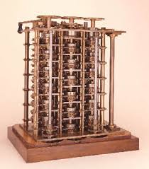
Charles Babbage1830’s
He created the difference Engine analytic. The difference engine was used to compute specific polynomials (ex. X2 + x + 4) It was often said that Babbage was a hundred years ahead of his time and the technology of his day.

Slide 11
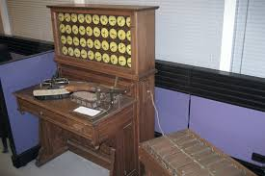
Sorting and tabulating machine 1890
Herman Hollerith combined the old technology of punched cards with the new electric technology of vacuum tubes. In this machine, wires poked through the holes in the punched cards then into cups of Mercury.

Slide 12
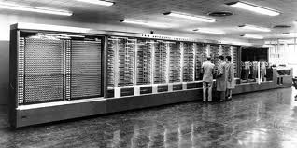
Mark One1937
Howard Aiken developed the Mark1 which was a electromechanical computer. It punched paper tape and used decimal architecture. It took 4.5 seconds to multiply two 23 digit numbers.

Slide 13
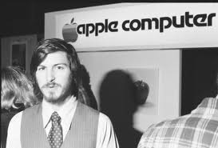
Steve Jobs
Steve Paul "Steve" Jobs (February 24, 1955 – October 5, 2011) was an American entrepreneur, marketer, and inventor. Who was the co-founder (along with Steve Wozniak and Ronald Wayne), chairman, and CEO of Apple Inc. Through Apple, he is widely recognized as a charismatic pioneer of the personal computer revolution and for his influential career in the computer and consumer electronics fields, transforming "one industry after another, from computers and smartphones to music and movies".

Slide 14
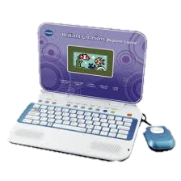
The Laptop1979
A laptop is a portable personal computer with a clamshell form factor, suitable for mobile use. They are also sometimes called notebook computers or notebooks. Laptops are commonly used in a variety of settings, including work, education, and personal multimedia. They are frequently used as a primary PC platform amongst young people.
A laptop combines the
components and inputs
as a desktop computer;
including display, speakers
keyboard, and pointing device into a single device.

